Slide 1
AEM (Adobe Experience Manager) Getting Started

Slide 2
What is AEM?
A web-based content management system (CMS) tool.
Enables organizations to create websites, manage content and digital assets of the website through several medium like mobiles, web browsers, tabs, desktops and more.
It also helps businesses to target right customer with right opportunity at right time through personalization (campaigns).

Slide 3
What is CMS?
This is a software application that aids create, manage or modify digital content. Besides, you can add, edit or delete any published content of your website using this tool.
Used to manage the content of companies’ web pages and websites. Users can store images using CMS, as well as for document and asset management
Helps site owners to create and delete website sections, edit website content without the participation of professionals. This is the major advantage over static websites.
Cost effective since no need to invest on developers.

Slide 4
Popular CMS tools
Below are few popular tools in market developed for different purposes, but their many functions are similar.
Wordpress -more than 60% of web content is developed using this tool.
Drupal - create content and templates both for private blogs and government entities
Magento - developing content for e-commerce purposes
Squarespace - website helping build blogs and hosting.
Joomla
Bitrix
Modx
Wix etc

Slide 5
History of AEM
Formerly known as CQ5.
Started by a Swiss company day software in early 2000 with the name “communique”.
CQ is the short form of “communique
CQ acquired by Adobe systems in 2010 after day CQ 5.3 release and subsequently renamed as Adobe Experience Manager (AEM) and release AEM 6.0 version
AEM 6.5 released in 2019 (Current).

Slide 6
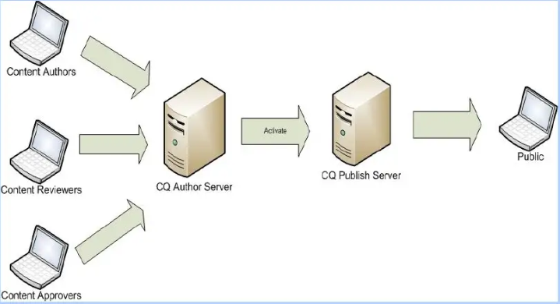
AEM Overview

Slide 7
Job ROLES in MARKET
Content Authors
AEM Developers- Including Component And OSGI Development
AEM Front End Developers
Analytics
AEM Testing
Architect
AEM Devops i.e. Admin role

Slide 8
pre-requisites
JAVA - Be very good at fundamentals of java programming
SERVLETS - basics
JSP - although we can still use jsps to develop the components, adobe has moved on and recommends using Sightly. This also helps UI developers to focus on UI related technologies and not learn another java-related language in their code.
SIGHTLY - Not a big topic, but need to have understanding of how to use it.
HTML, CSS/Bootstrap/Responsive Design - This is very key for the UI role
Javascript - Be strong

Slide 9
AEM Architecture

Slide 10
Thank YOU

